Slide 1

TIC TAC TOE WITH AI
Project created with the help of minimax algorithm

Slide 2
Tech Requirements
Programming Knowledge
Minimax Algorithm
Code editor

Slide 3
Know about the game
9*8*7*6*5*4*3*2*1 = 9! ( 362,880 ways to fill the particular places in board)
That’s a total of 3*3*3*3*3*3*3*3*3 = 3^9 = 19,683 different ways the 3x3 grid can be filled in.

Slide 4
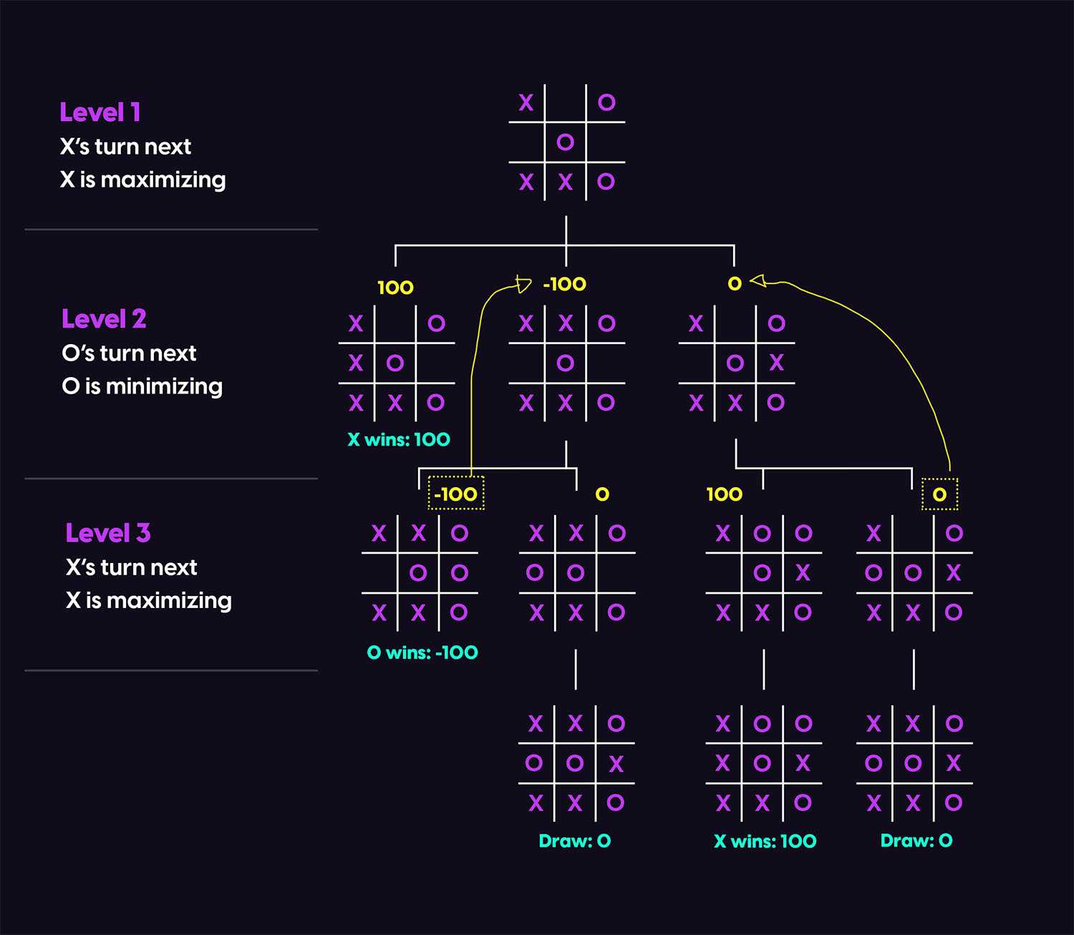
Game tree example

Slide 5
Implementation of minimax algorithm
To begin, let's start by defining what it means to play a perfect game of tic tac toe:
If I play perfectly, every time I play I will either win the game, or I will draw the game. Furthermore if I play against another perfect player, I will always draw the game.
How might we describe these situations quantitatively? Let's assign a score to the "end game conditions:"
I win, hurray! I get 10 points!
I lose, shit. I lose 10 points (because the other player gets 10 points)
I draw, whatever. I get zero points, nobody gets any points.
So now we have a situation where we can determine a possible score for any game end state.

Slide 6
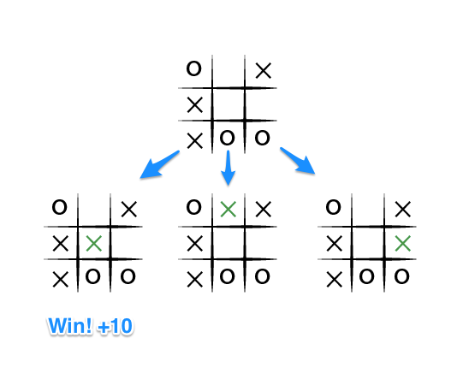
Implementation of minimax algorithm
User Turn(X) : Maximizer
If the top of this image represents the state of the game I see when it is my turn, then I have some choices to make, there are three places I can play, one of which clearly results in me wining and earning the 10 points. If I don't make that move, O could very easily win. And I don't want O to win, so my goal here, as the first player, should be to pick the maximum scoring move.

Slide 7
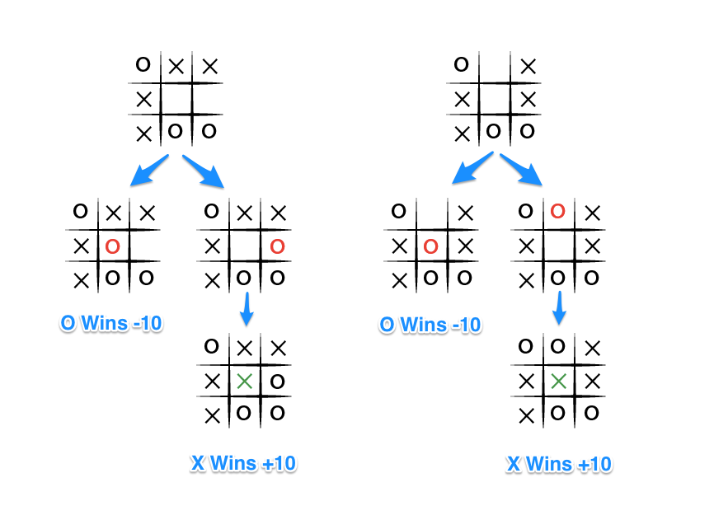
Implementation of minimax algorithm
Computer Player(Minimizer)
What do we know about O? Well we should assume that O is also playing to win this game, but relative to us, the first player, O wants obviously wants to chose the move that results in the worst score for us, it wants to pick a move that would minimize our ultimate score. Let's look at things from O's perspective, starting with the two other game states from above in which we don't immediately win:

Slide 8
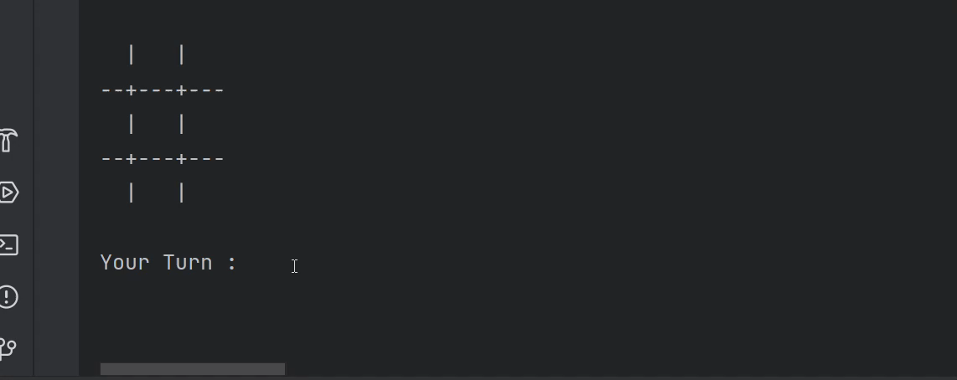

Slide 9

Thank You
Created by: adarsh mishra
Course : MCA (Last year)
Roll no: 2022073004

